Slide 1

Experiential Learning
Project Assessment-I
on
“ English to Hindi Translator ”
under the course
Python Programming Language (N-PCCCM304P)
Presented By
HIMANSHU SHRIDHAR WAGHAYE
USN: CM25019
Under the Guidance
of
Mrs. Suchita Mesakar
Session: 2026-27 (ODD)
Department of CSE(AI&ML)
S. B. JAIN INSTITUTE OF TECHNOLOGY MANAGEMENT AND
RESEARCH, NAGPUR
S. B. Jain Institute of Technology Management and Research

Slide 2
Contents
1
Problem Statement
Understanding the translation problem and expected input/output.
2
Objectives
Goals and learning outcomes of the project.
3
Algorithm
Step-by-step logic and approach to translate English text.
4
Flowchart and Python Logic
Visual representation and Python concepts used.
5
Pseudocode
Language-independent logic of the translator.
6
Working / Sample Output
Example input, processing and Hindi output.
7
GitHub
Repository creation, uploading code and meaningful commits.
S. B. Jain Institute of Technology Management and Research

Slide 3
Problem Statement
Project Aim
Processing
The project aims to create a Python application that accepts English words, sentences or short paragraphs and translates them into Hindi using a predefined dictionary or a translation API.
Validate input → identify translation method → process text → handle errors.
Output
Hindi translation is displayed clearly and accurately.
Example:
“सुप्रभात, आप कैसे हैं?”
Input
English text entered by the user.
Example: “Good morning, how are you?”
Key Requirement
Simple, user-friendly interface + Python concepts + API usage + exception handling.
S. B. Jain Institute of Technology Management and Research

Slide 4
Objectives
Understand
Learn how a translator accepts source text and produces target-language text.
EN
Translate
Convert English words, sentences or paragraphs into Hindi.
→
Apply Python
Use strings, dictionaries, functions, conditions and loops.
HI
Use APIs
Understand how a translation API can extend the application.
English → Translation → Hindi
S. B. Jain Institute of Technology Management and Research

Slide 5
Algorithm
1
Step 1
Take English text as input.
2
Step 2
Check whether the input is empty or valid.
3
Step 3
Select a predefined dictionary or translation API.
4
Step 4
Process the English text and obtain Hindi translation.
5
Step 5
Handle missing translation, network or API errors.
6
Step 6
Display the original text and final Hindi output.
Main Idea
INPUT → PROCESS → TRANSLATE → OUTPUT
S. B. Jain Institute of Technology Management and Research

Slide 6
Flowchart and Python Logic
Python Concepts
START
Error Handling
Strings
Dictionaries
Functions
If–elif conditions
Loops
input() / print()
Empty input
Unknown word
API failure
Network problem
Invalid response
Enter English Text
Is input empty?
Choose Dictionary / API
Translate Text
Display Hindi Output
END
S. B. Jain Institute of Technology Management and Research

Slide 7
Pseudocode
START
INPUT english_text
IF english_text is empty
DISPLAY "Please enter text"
ELSE
SELECT dictionary or API
TRANSLATE english_text
IF translation fails
DISPLAY error message
ELSE
DISPLAY English text
DISPLAY Hindi translation
END
Input
English: Good morning
Process
Find or request the corresponding Hindi translation.
Output
Hindi: सुप्रभात
S. B. Jain Institute of Technology Management and Research

Slide 8
Understanding of Python Logic
Strings
Dictionary
Used to store and manipulate the English text.
Stores fixed word mappings such as {"hello": "नमस्ते"}.
Functions
If–Elif
Separate input, translation and output into reusable blocks.
Checks empty input, method selection and result conditions.
Loops
Exception Handling
Can process words one by one for dictionary-based translation.
try/except prevents API or network errors from crashing the program.
S. B. Jain Institute of Technology Management and Research

Slide 9
Working / Sample Output
translations = {
"hello": "नमस्ते",
"good morning": "सुप्रभात",
"thank you": "धन्यवाद",
"book": "किताब"
}
text = input("Enter English text: ")
text = text.strip().lower()
if not text:
print("Please enter some text.")
elif text in translations:
print("Hindi:", translations[text])
else:
print("Translation not found.")
INPUT
Good morning
PROCESS
Dictionary lookup or API translation
OUTPUT
सुप्रभात
S. B. Jain Institute of Technology Management and Research

Slide 10
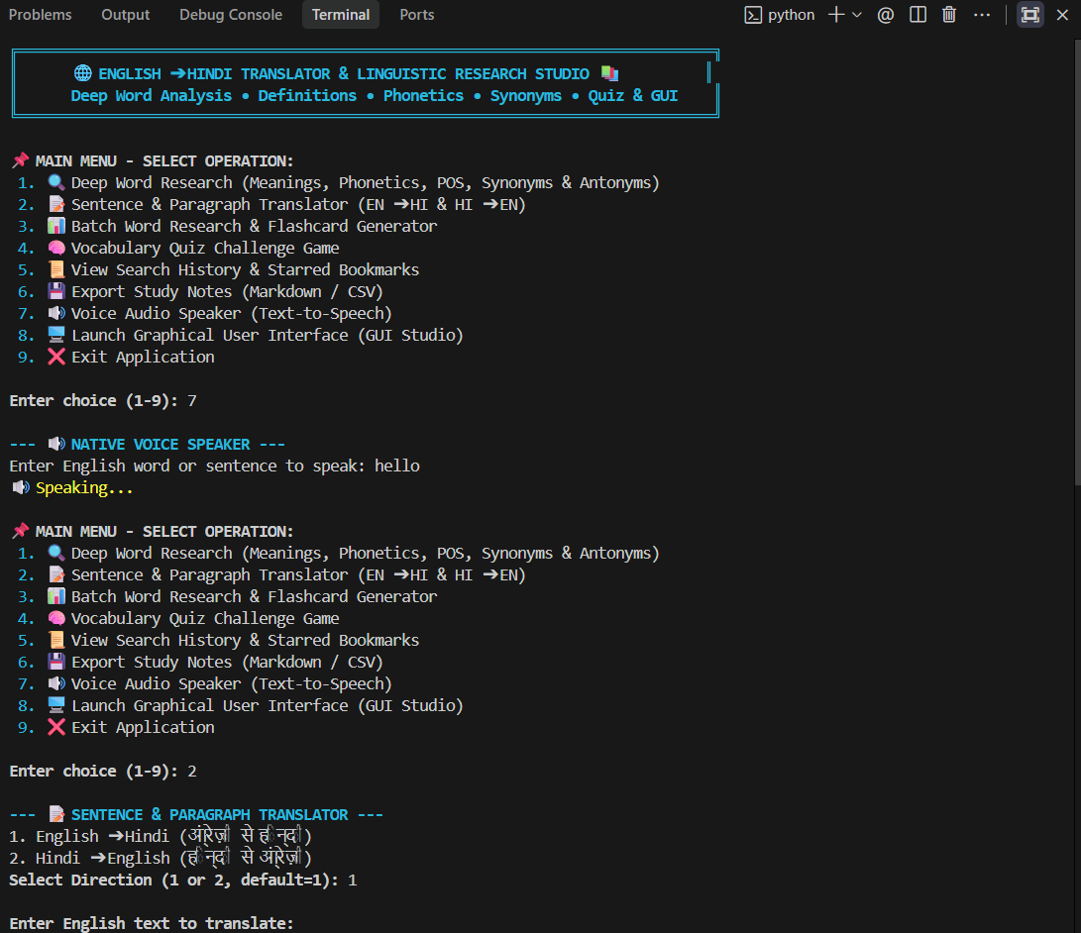
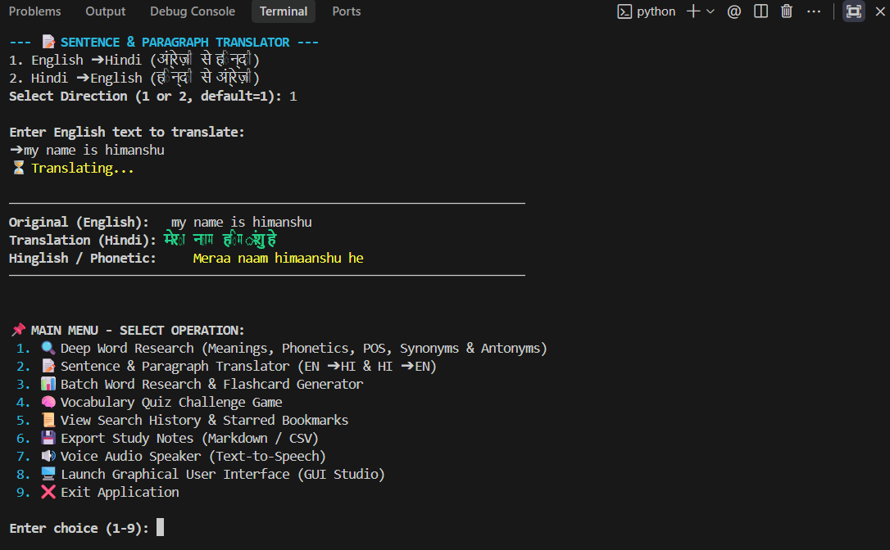
Output screenshot
S. B. Jain Institute of Technology Management and Research

Slide 11
GitHub
Create Account
Create Repo
Sign up or use an existing GitHub account.
Create a repository named english-to-hindi-translator.
Upload Code
Add README
Push the Python files and required project files.
Document the problem, features, setup and example output.
Meaningful Commits
Repository Link
Use clear commit messages while developing.
Copy the repository URL for submission.
Suggested Repository
english-to-hindi-translator
S. B. Jain Institute of Technology Management and Research

Slide 12
Conclusion
Learning Outcome
Practical Value
Future Scope
The project connects Python fundamentals with a practical language-processing problem and demonstrates how text can be accepted, processed and translated.
An English-to-Hindi translator can help users understand common English words and sentences in Hindi.
GUI using Tkinter
Voice input/output
More Indian languages
Translation history
Larger API support
Improved error handling
Final Message
A simple Python project can be extended into a useful multilingual application.
S. B. Jain Institute of Technology Management and Research

Slide 13
“Thank You”
English to Hindi Translator
HIMANSHU SHRIDHAR WAGHAYE
CM25019
S. B. Jain Institute of Technology Management and Research

